Slide 1
角色控制器

Slide 2
简介
The goal of the character controller SDK is to provide users with a default character controller built on top of the NVIDIA PhysX SDK. Roughly it has to support two things:
Character control
Character interactions
The goal is not to implement all of them
the goal is to give a default/sample implementation that people can use as a starting point

Slide 3
Kinematic Character Controller
In the past games did not use 'real' physics engines
such as Quake or even Doom, had a dedicated customized piece of code to implement collision detection and response
which was often the only piece of physics in the whole game
It actually had little physics, but a lot of carefully tweaked values to provide a good feeling while controlling the player
The particular behavior it implemented is often called the 'collide and slide' algorithm
The result is that players expect to find the same well-known behavior in new games
and providing them with anything else is often dangerous
if provided behavior is not as robust and stable as before
this is exactly what happens if you use a typical physics engine directly

Slide 4
problems using a physics engine for character controllers
(lack of) continuous collision detection
the tunneling effect itself : if your character goes too fast it might tunnel through a wall
as a consequence, the maximum velocity of your character might be limited (hence also limiting the game play possibilities)
even if you do not tunnel, the character might jitter when pushed forward in a corner for example, because the engine keeps moving it back and forth to slightly different positions.
No direct control
not possible to move it directly to its final position
first have to convert the delta position vector to impulses/forces, apply them
Usually it does not work too well
in particular when the physics engine uses an imperfect linear solver.
Notes:
(lack of) continuous collision detection: Typical physics engines use discrete collision checks, leading to the notorious 'tunneling effect' that has plagued various commercial & non-commercial physics packages for years. This leads to three main problems:
the tunneling effect itself : if your character goes too fast it might tunnel through a wall
as a consequence, the maximum velocity of your character might be limited (hence also limiting the game play possibilities)
even if you do not tunnel, the character might jitter when pushed forward in a corner for example, because the engine keeps moving it back and forth to slightly different positions.
No direct control: a rigid body is typically controlled with impulses or forces. It is usually not possible to move it directly to its final position, you first have to convert the delta position vector to impulses/forces, apply them, and hope that the character will be where you wanted it to be as a result. Usually it does not work too well, in particular when the physics engine uses an imperfect linear solver.
Trouble with friction: When the character is standing on a ramp, you do not want it to slide. You want infinite friction here. When the character is moving forward on that same ramp, you do not want it to slow down. You want no friction here. When the character is sliding against a wall, you do not want it to slow down either. You want no friction here as well. Usually it is either 0 or infinite. However the friction model might not be perfect, and what you actually get is very little friction (you can still feel the character slowing down) or a very-big-but-not-infinite one (the character slides very slowly on that ramp no matter how artificially big the friction parameters are). The conflicting requirements for ramps also mean that usually there is simply no way to perfectly model desired behavior.
Trouble with restitution: You should avoid restitution. When the character moves fast and collides with a wall, you do not want it to bounce away from it. When the character falls from a height and lands on the ground, flexing his legs, you definitely do not want any bounce to happen. But once again, even when the restitution is exactly zero, you can nonetheless sometimes get a small bump. This is not only related to the imperfect nature of the linear solver, it also has to do with how typical penetration-depth-based engines recover from overlap situations, sometimes applying excessive forces that separate the objects too much.
Undesired jumps: You often want a character to stick to the ground, no matter what the physical behavior should be. For example characters in action games tend to move fast, at unrealistic speeds. When they reach the top of a ramp, the physics engine often makes them jump a bit, in the same way a fast car would jump in the streets of San Francisco. But that is often not what you want: you want the character to stick to the ground regardless of its current velocity. This is sometimes implemented using fixed joints, which is an excessively complex solution to a very simple problem that can been solved without the complexity of a physics engine.
Undesired rotations: Finally, a character is always standing up and never rotating. However physics engines often have poor support for that sort of constraints, and a great deal of effort is often put into preventing a capsule around the character from falling (it should always stands up on its tip). This is again often implemented using artificial joints, and the resulting system is neither very robust nor very fast.

Slide 5
problems using a physics engine for character controllers
Trouble with friction
Trouble with restitution
When the character moves fast and collides with a wall, you do not want it to bounce away from it
Undesired jumps
For example characters in action games tend to move fast, at unrealistic speeds. When they reach the top of a ramp, the physics engine often makes them jump a bit. But you want the character to stick to the ground regardless of its current velocity
Undesired rotations
Finally, a character is always standing up and never rotating
Notes:
(lack of) continuous collision detection: Typical physics engines use discrete collision checks, leading to the notorious 'tunneling effect' that has plagued various commercial & non-commercial physics packages for years. This leads to three main problems:
the tunneling effect itself : if your character goes too fast it might tunnel through a wall
as a consequence, the maximum velocity of your character might be limited (hence also limiting the game play possibilities)
even if you do not tunnel, the character might jitter when pushed forward in a corner for example, because the engine keeps moving it back and forth to slightly different positions.
No direct control: a rigid body is typically controlled with impulses or forces. It is usually not possible to move it directly to its final position, you first have to convert the delta position vector to impulses/forces, apply them, and hope that the character will be where you wanted it to be as a result. Usually it does not work too well, in particular when the physics engine uses an imperfect linear solver.
Trouble with friction: When the character is standing on a ramp, you do not want it to slide. You want infinite friction here. When the character is moving forward on that same ramp, you do not want it to slow down. You want no friction here. When the character is sliding against a wall, you do not want it to slow down either. You want no friction here as well. Usually it is either 0 or infinite. However the friction model might not be perfect, and what you actually get is very little friction (you can still feel the character slowing down) or a very-big-but-not-infinite one (the character slides very slowly on that ramp no matter how artificially big the friction parameters are). The conflicting requirements for ramps also mean that usually there is simply no way to perfectly model desired behavior.
Trouble with restitution: You should avoid restitution. When the character moves fast and collides with a wall, you do not want it to bounce away from it. When the character falls from a height and lands on the ground, flexing his legs, you definitely do not want any bounce to happen. But once again, even when the restitution is exactly zero, you can nonetheless sometimes get a small bump. This is not only related to the imperfect nature of the linear solver, it also has to do with how typical penetration-depth-based engines recover from overlap situations, sometimes applying excessive forces that separate the objects too much.
Undesired jumps: You often want a character to stick to the ground, no matter what the physical behavior should be. For example characters in action games tend to move fast, at unrealistic speeds. When they reach the top of a ramp, the physics engine often makes them jump a bit, in the same way a fast car would jump in the streets of San Francisco. But that is often not what you want: you want the character to stick to the ground regardless of its current velocity. This is sometimes implemented using fixed joints, which is an excessively complex solution to a very simple problem that can been solved without the complexity of a physics engine.
Undesired rotations: Finally, a character is always standing up and never rotating. However physics engines often have poor support for that sort of constraints, and a great deal of effort is often put into preventing a capsule around the character from falling (it should always stands up on its tip). This is again often implemented using artificial joints, and the resulting system is neither very robust nor very fast.

Slide 6
Creating a character controller
first decide what bounding volume around characters
only boxes (PxBoxController) and capsules (PxCapsuleController) are supported.
Then create a controller manager
You only need one of them
it will keep track of all created controllers and allow your character to interact with other characters created by the same manager

Slide 7

Then you create one controller for each movable character in the game. This is done like this, for a capsule controller:

Slide 8
注意
Make sure that the character is not created in an initial overlap state
The character controller module does not check for overlaps itself, and creating a character that initially overlaps the world's static geometry can have undesired and undefined behavior
like the character going through the ground for example.
for each shape you want your controller to collide with, you must set the PxShapeFlag::eSCENE_QUERY_SHAPE to true

Slide 9
Updating a character controller
PxU32 collisionFlags = PxController::move(const PxVec3& disp, PxF32 minDist, PxF32 elapsedTime, const PxControllerFilters& filters, const PxObstacleContext* obstacles=NULL);
minDist is a minimal length used to stop the recursive displacement algorithm early when remaining distance to travel goes below this limit.
elapsedTime is the amount of time that passed since the last call to the move function.
filters are filtering parameters similar to the ones used in the SDK. These allow customization of filtering and control what the character is colliding with.
obstacles are optional additional obstacle objects with which the character should collide. Those objects are fully controlled by users and do not need to have counterpart SDK objects. It should be noted that touched obstacles are cached, meaning that the cache needs to be invalidated if the collection of obstacles changes.
collisionFlags is a bit mask returned to users to define collision events that happened during the move. This is a combination of PxControllerFlag flags. It can be used to trigger various character animations. For example your character might be falling while playing a falling idle animation, and you might start the land animation as soon as PxControllerFlag::eCOLLISION_DOWN is returned.

Slide 10
Obstacle objects
Sometimes it is convenient to create additional obstacles for the CCT to collide with, without creating an actual SDK object
the obstacles might only exist for a couple of frames, in which case creating and deleting SDK objects is not always efficient.
the obstacles might only exist for stopping the characters, not the SDK's dynamic objects
This would be for example invisible walls around geometry, that only the characters should collide with
In this case it may not be very efficient to create the invisible walls as SDK objects, since their interactions would then have to be filtered out for everything except the characters
the obstacles might be dynamic and updated with a variable timestep, while the SDK uses a fixed timestep
a moving platform on which the characters can stand.

Slide 11
first create a PxObstacleContext object using the following function:
Then manage obstacles with

Slide 12
Graphics update
Each frame, you need to keep your graphics object in sync with the position of the character controller
returns the position from the center of the collision shape
note that a controller never rotates so you can only access its position
Alternative helper functions if you need to work using the character's bottom position

Slide 13
Character Volume
The character uses a bounding volume that is independent from already existing shapes in the SDK
We currently support two different shapes around the character:
An AABB, defined by a position and an extents vector. The AABB does not rotate. It always has a fixed rotation even when the player is (visually) rotating. This avoids getting stuck in places too tight to let the AABB rotate, for example.
A capsule, defined by a position, a height and a radius. The capsule has a better behavior when climbing stairs for example. However it might be slightly more expensive in terms of CPU time.

Slide 14
A small skin is maintained around the character's volume, to avoid numerical issues that would
expand the volume by the size of this skin to get accurate debug visualization
This skin is defined in PxControllerDesc::contactOffset and later available through the PxController::getContactOffset() function

Slide 15
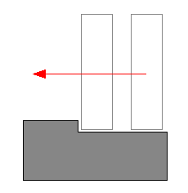
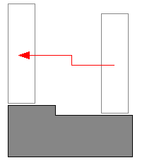
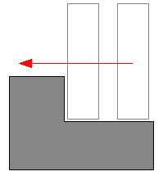
Auto Stepping

Slide 16
Walkable Parts
often want to disallow walking on polygons whose slope is high
All polygons whose slope is higher than the limit slope will be marked as non walk-able
In the future it may be possible to tag each triangle of a mesh as walk-able or not
Two modes are available to select what happens when touching a non walk-able part PxControllerDesc::nonWalkableMode enum
PxControllerNonWalkableMode::ePREVENT_CLIMBING prevents the character from moving up a slope, but does not move the character otherwise.
PxControllerNonWalkableMode::ePREVENT_CLIMBING_AND_FORCE_SLIDING not only prevents the character from moving up non walk-able slopes but also forces it to slide down those slopes.
The slope limit is defined in PxControllerDesc::slopeLimit and later available through the PxController::getSlopeLimit() function.
The limit is expressed as the cosine of desired limit angle. For example this uses a slope limit of 45 degrees:

Slide 17
Volume Update
Sometimes it is useful to change the size of the character's volume at runtime
if your character can crouch, you might want to reduce the height of its bounding volume so that it can then move to places he could not reach otherwise.
volumes are directly modified without any extra tests
the resulting volume overlaps some geometry nearby
To avoid this you must first use the already existing 'placement API' from the SDK, to check that the volume of space you want to occupy is actually empty. Only then can you increase the size of the character's volume.

Slide 19
changing the size of a controller using those functions does not actually change its position
if your character is standing on the ground (touching it), and you suddenly reduce its height without updating its position, the character will end up levitating above the ground for a few frames until gravity makes it fall and touch the ground again
This happens because the controllers positions are located at the center of the shapes, rather than the bottom
Thus, to modify a controller's height and preserve its bottom position, one must change both the height and position of a controller

Slide 20
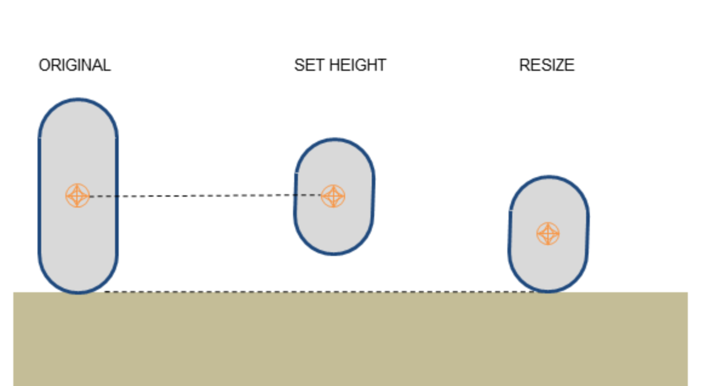

Slide 21
Hit callback
You can define a PxUserControllerHitReport callback that will let you retrieve some information about controller's evolution
when the character hits a shape, another character, or a user-defined obstacle object.
When the character hits a shape, the onShapeHit callback is called - for both static and dynamic shapes
Various impact parameters are sent to the callback, and they can then be used in your application to do various things like playing sounds, rendering trails, applying forces, and so on.
When the character hits another character, i.e. another object controlled by a character controller, the onControllerHit callback is called
This happens when the player collides with an NPC, for example.
When the character hits a user-defined obstacle, the onObstacleHit callback is called

Slide 22
Behavior callback
You can define a PxControllerBehaviorCallback callback that will let you customize the character's behavior after touching a PxShape, a PxController, or a PxObstacle

Slide 23
返回值
PxControllerBehaviorFlag::eCCT_CAN_RIDE_ON_OBJECT defines if the character can effectively travel with the object it is standing on. For example a character standing on a dynamic bridge should follow the motion of the PxShape it is standing on (e.g. in SampleBridges). But it should not be the case if the character stands on, say a PxShape bottle rolling on the ground (e.g. the snowballs in SampleNorthPole). Note that this flag only controls the horizontal displacement communicated from an object to the controller. The vertical motion is something slightly different, as many factors contribute to this displacement: the "step offset" used to automatically walk over small bumps, the vertical motion of underlying dynamic actors like e.g. the bridges in SampleBridges, that should probably always been taken into account, etc.
PxControllerBehaviorFlag::eCCT_SLIDE defines if the character should slide or not when standing on the object. This can be used as an alternative to the previously discussed slope limit feature, to define non walk-able objects rather than non-walkable parts. It can also be used to make a capsule character fall off a platform's edge automatically, when the center of the capsule crosses the platform's edge.
PxControllerBehaviorFlag::eCCT_USER_DEFINED_RIDE simply disables all built-in code related to controllers riding on objects. This can be useful to get the legacy behavior back, which can sometimes be necessary when porting to PhysX 3.x a piece of code built around the PhysX 2.x character controller. The flag simply skips the new codepath, and lets users deal with this particular problem in their own application, outside of the CCT library.

Slide 24
Character interactions
It is tempting to let the physics engine push objects by applying forces at contact points
However it is often not good for game play. The bounding volume around characters are artificial (boxes, spheres, etc) and you do not want the pushing effect to change when you switch from a box controller to a capsule controller.
You usually want a pushing effect dictated by game play. So it might actually be better to apply artificial forces to objects in the onShapeHit callback

Slide 25
Hidden kinematic Actors
The character controller library creates a kinematic actor under the hood, for each controlled character. The user should be aware of this, since the total number of actors in the scene is more than they created, and they might receive unknown actors from the scene when doing collision queries.
When you invoke the move function to move a PxController, the underlying hidden kinematic PxActor is also updated. The kinematic actors can be retrieved using the following function:

Slide 26
Time Stepping
Actors used internally by the character controller library follow the same rules as any other PhysX objects. In particular, they are updated using fixed or variable timesteps. This can be troublesome because the PxController objects are otherwise typically updated using variable time steps (usually using the elapsed time between two rendering frames). So the PxController objects are not always perfectly in sync with their kinematic actors when using fixed time steps.

Slide 27
Invalidating internal caches
The character controller library caches the geometry around each character, in order to speed up collision queries. In PhysX 3.3 and above, those caches should be automatically invalidated when a cached object gets updated. However it is also possible to manually flush those caches using the following function:

Slide 28
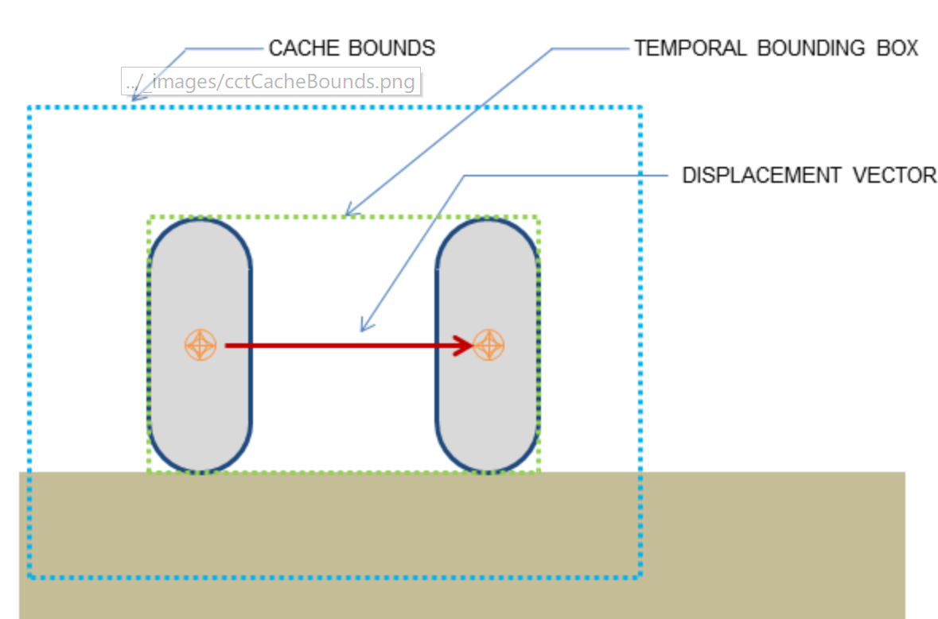

Slide 29
Runtime tessellation
tessellate the large triangles at runtime, replacing them on-the-fly with a collection of smaller triangles. The library supports a built-in tessellation feature, enabled with this function:
Notes:
The character controller library is quite robust, but sometimes suffers from FPU accuracy issues when a character collides against large triangles. This can lead to characters not smoothly sliding against those triangles, or even penetrating them. One way to effectively solve these problems is to tessellate the large triangles at runtime, replacing them on-the-fly with a collection of smaller triangles. The library supports a built-in tessellation feature, enabled with this function:
It is thus recommended to disable the feature at first, and only enable it if experiencing collision problems. When enabling the feature, it is recommended to use the largest possible maxEdgeLength that does fix encountered problems.

Slide 30
Overlap recovery module
The overlap recovery module can be used to depenetrate CCTs from static objects when an overlap is detected. This can happen in three main cases:

Slide 31
When activated, the CCT module will automatically try to resolve the penetration, and move the CCT to a safe place where it does not overlap other objects anymore. This only concerns static objects, dynamic objects are ignored by this module.
The overlap recovery module is enabled with this function:

Slide 32
By default the character controllers use precise sweep tests, whose accuracy is usually enough to avoid all penetration
in most cases the overlap recovery module is not needed
When it is used though, the sweep tests can be switched to less accurate but faster versions, using the following function:

